Slide 1
LLMs, bias and fairness

Slide 2
Definizioni
Bias (pregiudizio): “inclination or prejudice for or against one person or group, especially in a way considered to be unfair” (Oxford Languages)
Fairness (equita’/imparzialita’): “impartial and just treatment or behaviour without favouritism or discrimination” (Oxford Languages)

Slide 3
Google Scholar “llm bias” search
Returns 257,000 ‘hits’
Page 10 of results, 9/10 articles on target (one on cognitive bias in using LLM)
E c’e’ pure il gatto che si morde la coda …
“Investigating Bias in LLM-Based Bias Detection: Disparities between LLMs and Human Perception” (COLING 25)

Slide 4
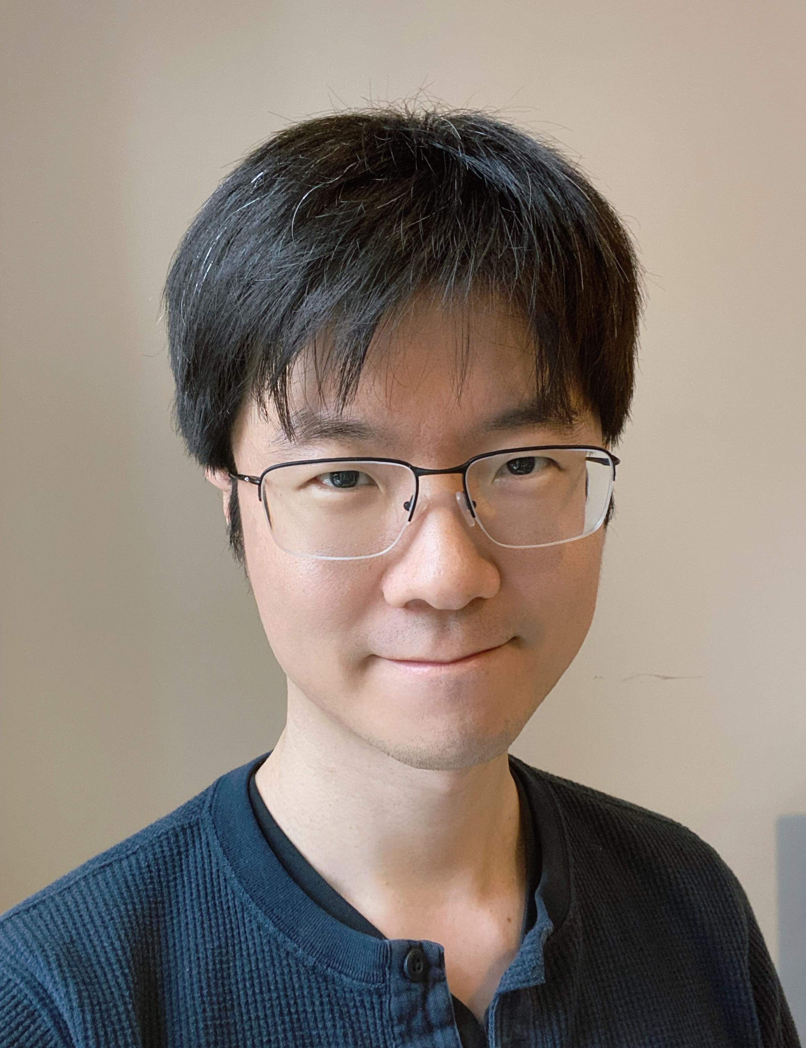


Unveiling Performance Challenges of LLMs in Low-Resource Healthcare: A Demographic Fairness Perspective (COLING 25)
Yue Zhou, Barbara Di Eugenio, Lu Cheng
Department of Computer Science
University of Illinois Chicago
Chicago, IL, USA

Slide 5
Introduction
Research Questions: Will LLMs be as successful in healthcare as they have been in other domains? Will they help mitigate health disparities and achieve health equity?
Challenges:
Breadth of domain knowledge
Limited data resources with demographic information
Inherent ethical considerations

Slide 6
Introduction: Motivations
✧ Lack of comprehensive evaluation of LLMs on real-world healthcare tasks:
- we propose 6 benchmarks and evaluate performance
✧ Concerns regarding biases towards certain groups and potential to reinforce health disparities:
- analysis from demographic fairness perspective

Slide 7
Four Datasets, Six Benchmarks
1. Medical Question Answering (US Medical Licensing Examination) [Jin et al 2021]
2. Patient goal achievement prediction from Health Coaching Datasets [Gupta et al 2020, Zhou et al 2024]
3+4. One-year mortality prediction and 90-day readmission - from MIMIC-IV [Johnson et al 2020]
5+6. Schizophrenia/Bipolar Disorder/Healthy prediction from spoken dialogues:
Meeting New Neighbor and Complaining to a Landlord [Aich et al 2022]
Notes:
They all include demographic information . MIMIC-IV contains data for over 65,000 patients admitted to an ICU and over 200,000 patients admitted to the emergency department.

Slide 8
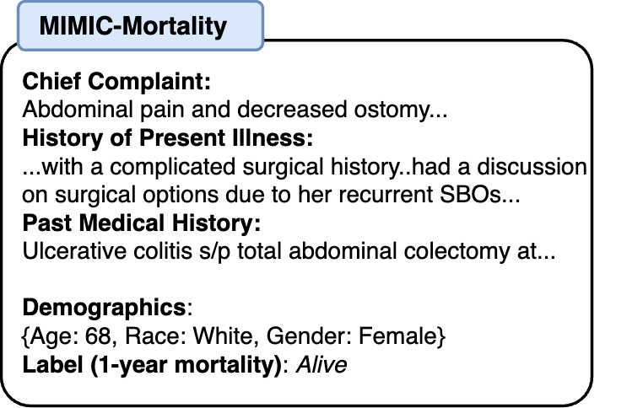
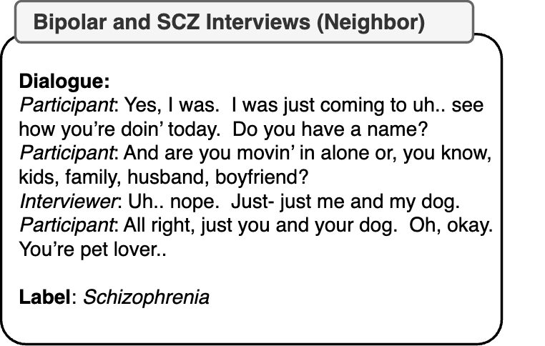

Slide 9
Dataset Statistics
Task | Fine-Tuning | Test
MIMIC-Mortality | 5000 | 500
MIMIC-Readmission | 5000 | 500
MedQA | 5000 | 175
Health Coaching | 120 | 60
SCZ and Bipolar: Neighbor | 190 | 261
SCZ and Bipolar: Landlord | 188 | 261
Notes:
For tasks with access to larger databases (MIMIC and MedQA), we intentionally capped the training data at 5000 examples to mimic similar low-resource
conditions. We sample each dataset such that the classes C, the demographic attributes Z, and the distribution P(C = c|Z = z) are roughly balanced.

Slide 10
Three approaches, three LLMs
In-Context Learning (ICL) with Chain-of-Thought
OpenAI GPT-4
Claude-3 (Sonnet)
LLaMA-3 (8b)
Parameter Efficient Fine-Tuning (PEFT) (LoRA)
LLaMA-3 (8b)
LLM as Agents (ReAct and Reflexion) [external knowledge]
OpenAI GPT-4

Slide 11
Prompt example:
Mortality / Readmission: Assess the 1-year mortality risk (low or high) / 90-day readmission chance for the patient based on the given de-identified clinical note. Using medical evidence only. If uncertain, provide your best evidence-based estimate.
[Note]
Chief complaint / history of present illness / past medical history / lab results.

Slide 12
LLM as Agents
Simplified
“LLM as Agents”
Framework

Slide 13
Results: Accuracy
Baselines | Backbones | Mortality (Mimic) | MedQA | SCZ/Bipolar (Neighbor) | SCZ/Bipolar (Landlord)
Random Guess | - | 50.0 | 20.0 | 33.3 | 33.3
Chain-of-Thought | GPT-4 | 77.0 (79.0) | (68.6) | 41.0 (39.1) | 28.2 (36.8)
Chain-of-Thought | Claude-3 | 72.6 (50.8) | (65.7) | 37.5 (38.3) | 37.2 (34.1)
Chain-of-Thought | LLaMA-3 | 73.0 (72.2) | (59.4) | 33.0 (33.3) | 34.1 ( 33.7)
Supervised Fine-Tuning | LLaMA-3 | 68.2 | 71.4 | 49.4 | 41.4
LLM as Agent | GPT-4 | 66.7 | 86.9 | 36.8 | 36.8
LLMs perform so so on real-world healthcare tasks: some models barely surpass random guess
While often close-source > open-source, best framework varies by tasks (e.g. Mortality vs SCZ/Bipolar)
Agent approach works for MedQA, fails real-world cases
Demographics prompting shows mixed results
Notes:
Only 4 of 6 (full results in paper)
First row – random guess (MedQA: 5 answers; SCZ/biplora/healthy)
Bold: best result per column
In (): prompt with addition of demographic info
COT cgot4 best for Mortality but Llama foinetuning best for bipolar
Including demographic info in prompt helps or doesn’t hurt too much; but in underlined, hurts a lot
Let’s focus on Mortality and Mental health

Slide 14
Two Metrics for Fairness [Zemel et al 2013, Liu et al 2023]
Demographic Parity Difference (DPD) tests whether model treats various subgroups similarly
Ŷ = outcome, Z= protected attribute (demographic information)
Does not consider ground truth
DPD = P( Ŷ = 1 | 𝑍 = 𝑧_{𝑖} ) - P( Ŷ = 1 | 𝑍 ≠ 𝑧_{𝑖} )

Slide 15
Two Metrics for Fairness
Equal Opportunity Difference (EOD)
measures whether different subgroups have equal likelihood of being accurately classified
Ŷ = outcome, Y= ground truth, Z= protected attribute (demographic information)
EOD = P( Ŷ = 1 | 𝑌 = 1, 𝑍 = 𝑧_{𝑖} ) - P( Ŷ = 1 | 𝑌 = 1, 𝑍 ≠ 𝑧_{𝑖} )

Slide 16
Fairness – Predict Mortality
Setting | DPD |  | EOD
 | AfrAm - White | Fem - Male | AfrAm - White | Fem - Male
COT-GPT-4 | -8.2 (-7.4) | -5.1 (-2.7) | -2.5 (-4.4) | -4.6 (-5.3)
COT-Claude-3 | -11.5 (-6.4) | -8.7 (+1.5) | -3.8 (-3.8) | -4.5 (-7.2)
COT-LLaMA-3 | -8.3 (-17.6) | -2.8 (-3.0) | -4.2 (-8.0) | -5.9 (-5.2)
FinTun LlaMA-3 | -14.3 | -12.7 | -9.4 | -5.3
Agent (GPT-4) | +2.1 | -2.1 | +2.4 | +2.8
Unfairness present across all tasks, more in race than gender
African American patients consistently receive less favorable predictions
Fine-tuning improves fairness for some tasks (readmission) but worsens others (mortality, health coaching)
Notes:
First number as is, in parenthesis fine-tuning. FinTun Llama-3 / Agent – no non fine tuned version.

Slide 17
Additional Experiments: Demographic Awareness and Bias in Conversation
Accuracy in predicting patient’s race in conversational data:
Ask for explanation: Trite stereotypes in LLaMA reasoning (in paper appendix)
 | Health Coaching | SCZ/Bipolar (Neighbor) | SCZ/Bipolar (Landlord)
Random | 33.3 | 50.0 | 50.0
GPT-4 | Refusal | 75.3 | 78.8
Claude-3 | Refusal | Refusal | Refusal
LLaMA-3 | 40.0 | 59.6 | 61.7
Notes:
Given our 3 conversational datasets, asked to predict race of speaker. HC: AA/W/H; SCZ:AA/W

Slide 18
Conclusions & Future Work
LLMs are not as performant in real-world healthcare tasks
Substantial differences in Demographic Parity and more importantly in Equal Opportunity
Need: more healthcare data with demographic information
Big question: how to mitigate bias and improve fairness?

Slide 19
References (COLING 25)
1.Alistair Johnson, Lucas Bulgarelli, Tom Pollard,Steven Horng, Leo Anthony Celi, and Roger Mark.2020. Mimic-iv. PhysioNet. Available online at:https://physionet. org/content/mimiciv/1.0/(accessed August 23, 2021).
2. Itika Gupta, Barbara Di Eugenio, Brian Ziebart, Aiswarya Baiju, Bing Liu, Ben Gerber, Lisa Sharp, Nadia Nabulsi, and Mary Smart. 2020. Human-human health coaching via text messages: Corpus,annotation, and analysis. In Proceedings of the 21th Annual Meeting of the Special Interest Group onDiscourse and Dialogue, pages 246–256, 1st virtual meeting. Association for Computational Linguistics.
Yue Zhou, Barbara Di Eugenio, Brian Ziebart, Lisa Sharp, Bing Liu, and Nikolaos Agadakos. 2024b.Modeling low-resource health coaching dialogues via neuro-symbolic goal summarization and text-units-text generation. In Proceedings of the 2024 Joint International Conference on Computational Linguis-tics, Language Resources and Evaluation (LREC-COLING 2024), pages 11498–11509, Torino, Italia.ELRA and ICCL.
3. Ankit Aich, Avery Quynh, Varsha Badal, Amy Pinkham, Philip Harvey, Colin Depp, and Natalie Parde. 2022. Towards intelligent clinically-informed lan- guage analyses of people with bipolar disorder and schizophrenia. In Findings of the Association for Computational Linguistics: EMNLP 2022, pages 2871–2887, Abu Dhabi, United Arab Emirates. As- sociation for Computational Linguistics.
4. Di Jin, Eileen Pan, Nassim Oufattole, Wei-Hung Weng, Hanyi Fang, and Peter Szolovits. 2021. What disease does this patient have? a large-scale open domain question answering dataset from medical exams. Applied Sciences, 11(14):6421.
5. Jason Wei, Xuezhi Wang, Dale Schuurmans, Maarten Bosma, Fei Xia, Ed Chi, Quoc V Le, Denny Zhou, et al. 2022. Chain-of-thought prompting elicits reasoning in large language models. Advances in Neural nformation Processing Systems, 35:24824–24837.
Takeshi Kojima, Shixiang (Shane) Gu, Machel Reid, Yutaka Matsuo, and Yusuke Iwasawa. 2022. Large language models are zero-shot reasoners. In Advances in Neural Information Processing Systems, volume 35,pages 5547–5560
Yue Zhou, Yada Zhu, Diego Antognini, Yoon Kim, and Yang Zhang. 2024c. Paraphrase and solve: Exploring and exploiting the impact of surface form on mathematical reasoning in large language models. In Proceedings of the 2024 Conference of the North American Chapter of the Association for Computational Linguistics: Human Language Technologies (Volume 1: Long Papers), pages 2793–2804, Mexico City, Mexico. Association for Computational Linguistics.
6. Edward J. Hu, Yelong Shen, Phillip Wallis, Zeyuan Allen-Zhu, Yuanzhi Li, Shean Wang, Lu Wang, and Weizhu Chen. 2022. Lora: Low-rank adaptation of large language models. In International Conference on Learning Representations (ICLR).
7. Shunyu Yao, Jeffrey Zhao, Dian Yu, Nan Du, Izhak Shafran, Karthik Narasimhan, and Yuan Cao. 2023. React: Synergizing reasoning and acting in language models. In The Eleventh International Conference on Learning Representations.
8.Noah Shinn, Federico Cassano, Edward Berman, Ashwin Gopinath, Karthik Narasimhan, and Shunyu Yao. 2023. Reflexion: Language agents with verbal reinforcement learning. In Advances in Neural Information Processing Systems (NeurIPS).

Slide 20

Additional slides

Slide 21
6 Datasets and Task Formulations

Slide 22
Results: Accuracy
Baselines | Backbones | Mortality | Readmission | MedQA | HealthCo | Neighbor | Landlord
Random Guess | - | 50.0 | 50.0 | 20.0 | 50.0 | 33.3 | 33.3
ICL/Chain-of-Thought | GPT-4 | 77.0 (79.0) | 55.3 (56.8) | -(68.6) | 76.7 (76.7) | 41.0 (39.1) | 28.2 (36.8)
ICL/Chain-of-Thought | Claude-3 | 72.6 (50.8) | 52.9 (57.6) | -(65.7) | 80.0 (80.0) | 37.5 (38.3) | 37.2 (34.1)
ICL/Chain-of-Thought | LLaMA-3 | 73.0 (72.2) | 53.3 (55.3) | -(59.4) | 70.0(70.0) | 33.0 (33.3) | 34.1 ( 33.7)
Supervised Fine-Tuning | LLaMA-3 | 68.2 | 48.2 | 71.4 | 70.0 | 49.4 | 41.4
LLM as Agent | GPT-4 | 66.7 | 53.3 | 86.9 | 70.0 | 36.8 | 36.8
LLMs struggle with real-world healthcare tasks (Some barely surpass random guess)
While generally close-source > open-source, best framework varies by tasks
Agent approach works for MedQA, fails real-world cases
Demographics prompting shows mixed results

Slide 23
Results: MedQA Accuracy
Baselines | Accuracy
 | African-American | Asian | Hispanic | White
COT-GPT-4 | 62 | 60 | 68 | 84
COT-Claude-3 | 64 | 62 | 60 | 74
COT-LLaMA-3 | 60 | 56 | 52 | 66
SFT (LLaMA-3) | 86 | 62 | 52 | 76
Agent (GPT-4) | 86 | 86 | 88 | 88
Discrepancy in in-context learning performance in MedQA targeting different racial groups
LLM-as-Agent trivially works well since it can access answer from internet

